Slide 1
Hepatocellular carcinoma in West Africa: risk factors and pathogenesis
Dr Richard Phillips
KNUST/KATH

Slide 2
Introduction
0.25-1.2 million cases worldwide per year
5th most common human cancer
80% of burden in developing countries
One of the 3rd most common cancers in these countries
Shortest survival time of any cancer in males and females
Prognosis poorer in low-income countries

Slide 3
HCC in Africa
sub-Saharan Africa
Most common cause of cancer deaths
Carries a particularly grave prognosis
Tumours usually larger
Men affected more often than women
Higher incidence in rural than in urban areas
Occurs at a relatively young age
Patients often present at a late stage

Slide 4
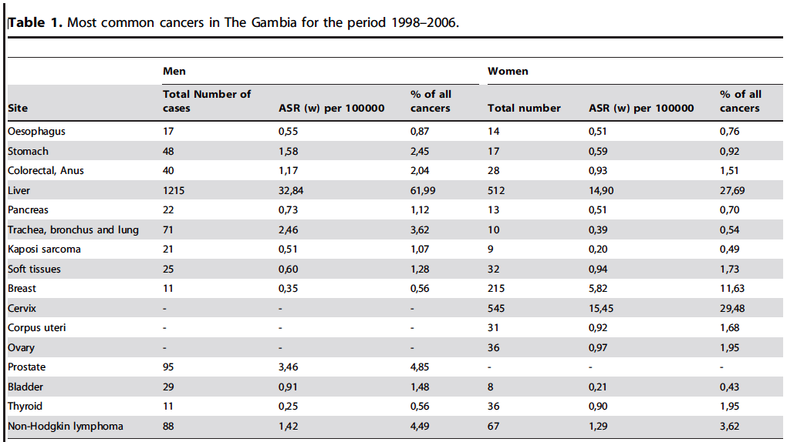
Evidence from 19 Years of Population-Based
Cancer Registration in Gambia(1988–2006)
Notes:
Background: Hepatocellular Carcinoma (HCC) is a common malignancy worldwide with a high burden in West Africa. Male
to female ratios show consistent bias toward males, the biological bases and variations of which are not well understood.
We have used data from the Gambian National Cancer Registry to compare trends in incidence of HCC in both genders.
Methods and Findings: Two periods were compared, 1988–1997 (early) and 1998–2006 (recent). In addition, the regression
program joinpoint was used to assess trends over 19 years. Differences with self-reported ethnicity were assessed for the
recent period using population data from 2003 census. Male to female ratio showed a significant decrease between the two
periods from 3.28:1 (95% CI, [2.93–3.65]) to 2.2:1 (95% CI, [1.99–2.43]). Although rates in males were relatively stable (38.36
and 32.84 for, respectively, early and recent periods), they increased from 11.71 to 14.9 in females with a significant Annual
Percentage Change of 3.01 [0.3–5.8] over 19 years and an increase in number of cases of 80.28% (compared to 26% in
males). Significant variations in HCC risk, but not in gender ratio were observed in relation with ethnicity.
Conclusion: This analysis of the only national, population-based cancer registry in West Africa shows a significant increase in
HCC in females over recent years. This increase may be the consequence of major changes in lifestyle or viral risk factors, in
particular obesity and hepatitis C, which have both been documented to increase in West Africa during recent years.

Slide 5
HCC in Gambia
Male:
62% of all cancers
54.2% HBV+ve
Mean age 45yr
Female: 28% of all cancers
36.6% HBV+ve
Mean age 46yr

Slide 6
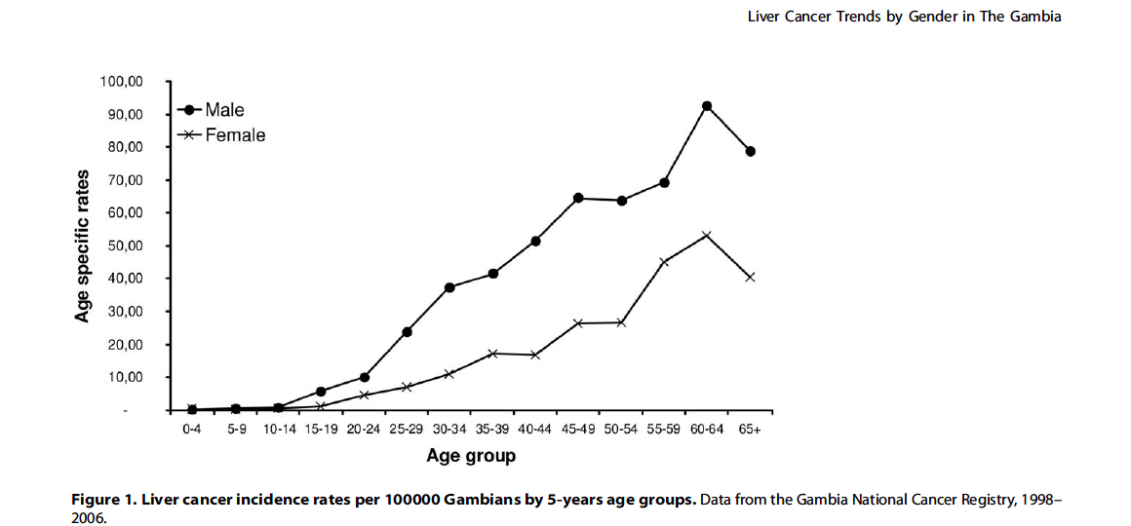

Slide 7
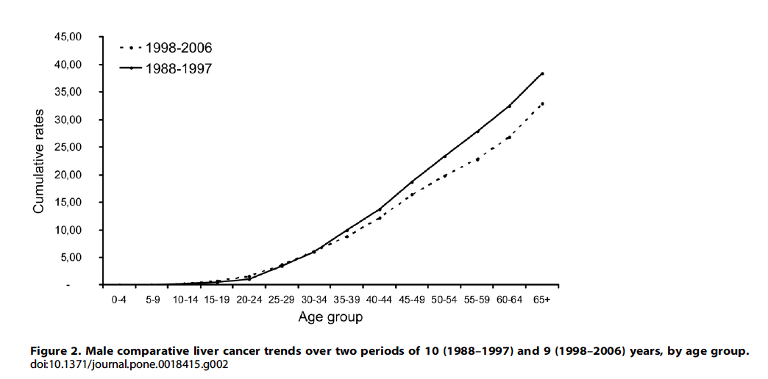

Slide 8
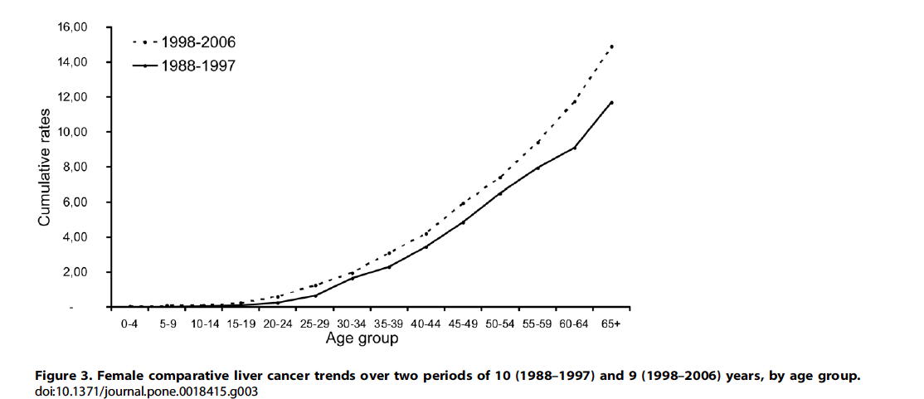

Slide 9
500
Mozambique
China
200
100
50
Spain
20
Annual incidence/100 000 men
10
5
Norway
2
1
0
10
20
30
40
50
60
70
+
Age

Slide 10
Medical admissions with HCC at KATH (Jan-June 2013)
Age (year) | Male | Female | Total
0-19 | 3 | 0 | 3
20-29 | 10 | 3 | 13
30-39 | 24 | 6 | 30
40-49 | 19 | 4 | 23
50-59 | 17 | 1 | 18
60-69 | 8 | 1 | 9
70-79 | 4 | 1 | 5
80-89 | 1 | 0 | 1
 | 86 | 16 | 102

Slide 11
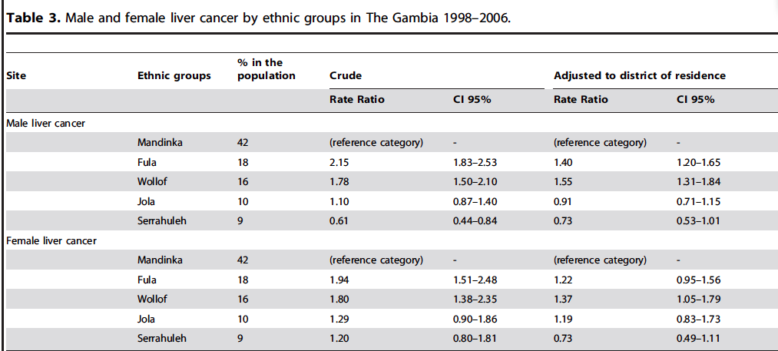
Ethnicity and HCC

Slide 12
Ethnicity and HCC
Higher incidence in Fula and Wollof ethnicity
Increase due to genetic polymorphism in enzymes in AFB1 metabolism
Higher prevalence between Fula and Mandinka in Gly 399 Allele of XRCC1 responsible for genetic repair of DNA aflatoxin adducts
Kirk GD 2005 Cancer Epid Biomarkers Prev 14: 373-379

Slide 13
Why the high incidence in Africa?
Three major environmental causes
Chronic HBV infection
Dietary exposure to fungal toxin aflatoxin B1
Chronic HCV infection

Slide 14
Why the high incidence of HCC in Africa?
Lesser risk factors
Alcohol
Metabolic conditions associated with obesity and/or T2DM
Dietary iron overload
Incidence vary widely as a function of geography and local prevalence of chronic viral hepatitis

Slide 15
Epidemiology of HBV infection in Africa
+ 65 million chronically infected
Responsible for + 255,000 deaths each year
Chronic carriage more common in males (1.5-2.0 : 1.0)
More common in rural than in urban dwellers

Slide 16
Consequences of early hepatitis B virus infection
Infected in 1st year of life: 90% become chronic
Infected in 5th year of life: 50% become chronic
Infected in adulthood: < 10% become chronic
27- 40% DEVELOP H.C.C
RELATIVE RISK OF H.C.C: > 100

Slide 17
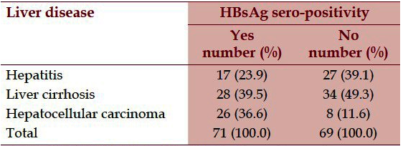
Hepatitis B Surface Antigenaemia among Adult Nigerians with Clinical Features of Liver Diseases
Notes:
Sero-epidemiology of Hepatitis B Surface Antigenaemia among Adult Nigerians with Clinical Features of Liver Diseases Attending a Primary-Care Clinic in a Resource-Constrained Setting of Eastern Nigeria
140 adult Nigerians with clinical features of liver diseases at the primary-care clinic of Federal Medical Centre, Owerri.
One-step test strip manufactured by ACON Laboratories Inc. (Sorrento Valley, San Diego, CA, USA).
Overall seroprevalence of 50.7 % Seroprevalence

Slide 18
PATHOGENESIS OF HEPATITIS B VIRUS-INDUCED HEPATOCELLULAR CARCINOMA
Unrestrained proliferation of hepatocytes
and
Series of genetic and epigenetic changes
  Dividing cells susceptible to viral integration
  Accelerated hepatocyte turnover rate allows less
  time for DNA repair before cell divides again, ‘fixing’
  abnormal DNA in daughter cells

Slide 19
PATHOGENESIS OF HEPATITIS B VIRUS-INDUCED HEPATOCELLULAR CARCINOMA
HBV DNA does not contain an oncogene
HBV DNA integration occurs in almost all patients with
HBV-induced HCC
Cis-activation of cellular genes
1. Integration into or close to a gene disrupts the gene or
interferes with its function
2. Changes in flanking sequences
- deletions, translocations, duplications
Trans-activation of cellular genes
Mediated through signal transduction pathways
Two HBV proteins have trans-activating capability:
- x protein
- preS/S protein when 3’ truncated during integration

Slide 20
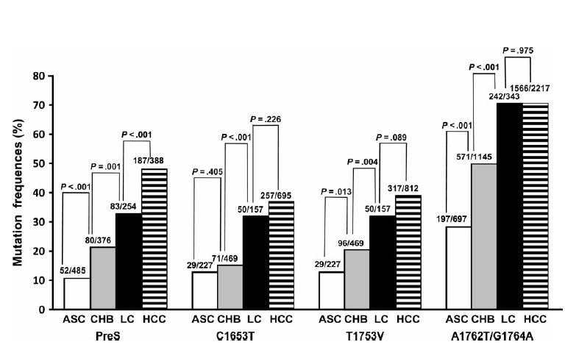
Associations Between Hepatitis B Virus Mutations and the Risk of Hepatocellular Carcinoma
Shijian Liu J Natl Cancer Inst 2009;101: 1066 – 1082
Notes:
Figure 4 . Frequencies of PreS, C1653T,
T1753V, or A1762T/G1764A mutations
among asymptomatic hepatitis B surface
antigen carriers (ASC), patients with chronic
hepatitis B (CHB), patients with liver cirrhosis
(LC), and patients with hepatocellular
carcinoma (HCC) from the pooled data.
P values (two-sided) are from the 2 test.
Absolute numbers of the participants with
hepatitis B virus mutation data are shown
on the top of each column. The numerators
represent the number of the patients (participants)
with the mutation(s). The denominators
represent subtotal number of the
patients (participants) with and without the
mutation(s).

Slide 21
Dietary exposure to fungal toxin aflatoxin B1
Difuranocoumarin derivatives of Aspergillus flavus and A. parasiticus
Contaminate crops, particularly maize, ground nuts and fermented soy beans, in tropical and subtropical countries
Associated with warm, humid climates
Contamination occurs both during growth of the crops and as a result of their improper storage.

Slide 22
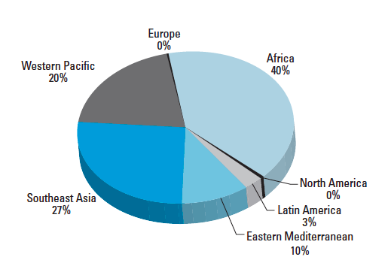
Distribution of HCC cases attributable to aflatoxin in different regions of the world.
Notes:
Global Burden of Aflatoxin-Induced Hepatocellular Carcinoma: A Risk Assessment
Yan Liu and Felicia Wu
Department of Environmental and Occupational Health, University of Pittsburgh, Pittsburgh, Pennsylvania, USA

Slide 23
Sub-Saharan Africa and the Asia-Pacific region have high levels of exposure to the fungal toxin.
Aflatoxin B1 (AFB1) is the aflatoxin most often found in contaminated human foodstuffs and is the most potent hepatocarcinogen
Strong statistical association between dietary ingestion of aflatoxin B₁ and the development of HCC
Wild CP Carcinogenesis 2010; 31: 71-82
Notes:
Wild CP, Gong YY. Mycotoxins and human disease: a large­ly ignored global health issue. Carcinogenesis 2010; 31: 71-82

Slide 25
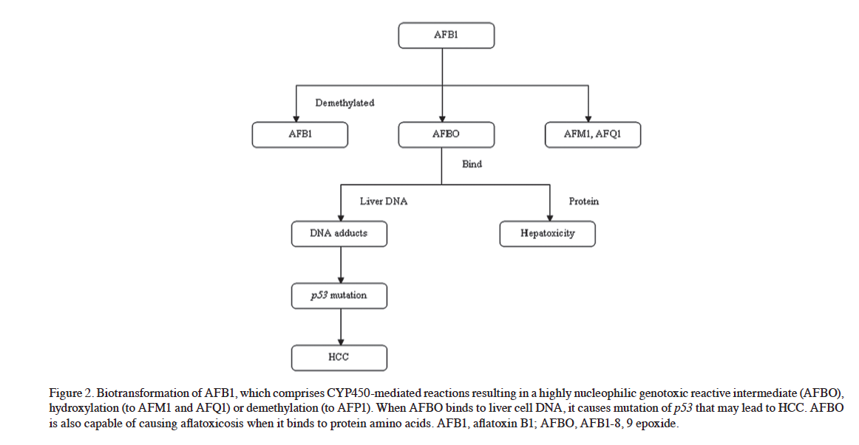
Biotransformation of AFB1

Slide 26
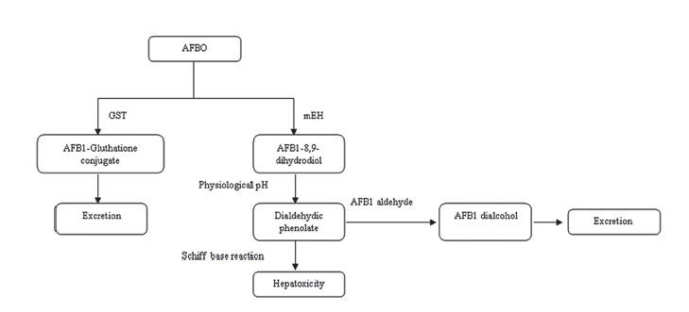
Detoxification pathway of AFBO

Slide 27

Individuals with mutant genotypes at epoxide hydroxylase and glutathione transferase M1 may be at greater risk of developing AFB1 adducts, p53 mutations, and HCC when exposed to AFB1.

Slide 28
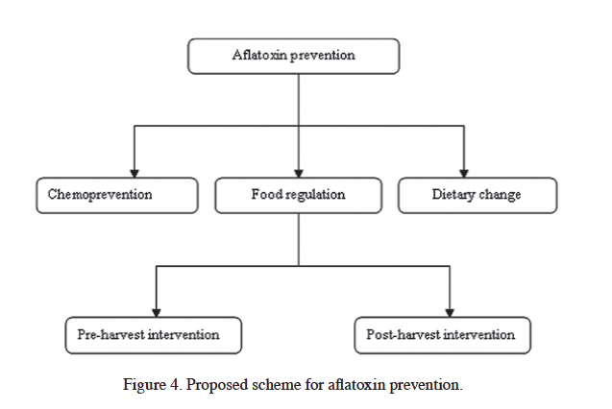

Slide 29
Chronic hepatitis C
Chronic hepatitis C virus (HCV) and HCV-induced HCC are significantly less common in developing than in developed countries
Notes:
Exception Somalia where chronic HCV infection is as common as chronic HBV infection(3)
Bile K, Aden C, Norder H, Magnius L, Lindberg G, Nilsson Z. Important role of hepatitis C virus infection as a cause of chronic liver disease in Somalia. Scand J Dig Dis 1993; 25: 559-564
In most rural regions of China, the population drinks primarily pond, ditch or river water. High concentrations of tumor-promoting microcystins, derived from blue-green algae, have been identified in these waters and high microcystin contents correlate with a high incidence of HCC[7,8].

Slide 31
PATHOGENESIS OF HCV-INDUCED HEPATOCELLULAR CARCINOMA
Unrestrained proliferation of hepatocytes
and
Series of genetic and epigenetic changes
HCV core and NS5a proteins:
  generate reactive oxygen species
  Repress transcription of p21
  Induces mutations in p53
  Abolishes catalytic activity of PKR (antiviral, antiproliferative induced by IFN)
Notes:
The PKR protein kinase is a critical component of the cellular antiviral and antiproliferative responses induced by interferons.

Slide 32
Hepatitis B and C induced HCC
Prevalence of cirrhosis in individuals with HCC and chronic Hep B was 80.9% or Hep C 75.8%
HCC occurs at a lower rate in Chronic Viral Hepatitis in the absence of cirrhosis
HCV is associated with more non-cirrhotics than cirrhotic HCC

Slide 33
INTERACTION BETWEEN HEPATITIS B AND C VIRUSES IN HEPATOCARCINOGENESIS
IN SOUTHERN AFRICAN BLACKS
RELATIVE RISK FOR H.C.C:
HBV INFECTION ALONE: 23.3 (9.2 - 51.8)
HCV INFECTION ALONE: 6.6 (2.7 - 15.7)
HBV AND HCV CO-INFECTION: 82.5 (8.9 - 761.8)

Slide 34
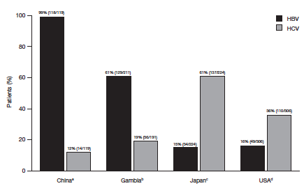
Variation in prevalence of chronic infection with HBV and HCV in patients HCC
Alan Venook The oncologist 2010 15:5-13

Slide 35
HEPATITIS B VIRUS INFECTION IN SOUTHERN AFRICAN BLACKS WITH HEPATOCELLULAR CARCINOMA
HBsAg: 69.5%
Anti-HBc alone: 10.9%
Anti-HBs: 19.2%
HBeAg: 27.6%
Anti-HBe:
In HBsAg +ve: 50.4%
In Anti-HBs +ve: 53.6%

Slide 36
HEPATITIS B VIRUS INFECTION IN SOUTH AFRICAN BLACKS WITH HEPATOCELLULAR CARCINOMA
HBsAg: 69.5%
occult HBV 22.5%
Total HBV positivity + 92%

Slide 37
AFRICAN DIETARY IRON OVERLOAD AS A CAUSE OF HEPATOCELLULAR CARCINOMA
  Gordeuk et al (1996): R.R. 23.5 (95% C.L. 2.1- 225) of
  HCC in those subjects with the highest levels of
  hepatic iron accumulation, after allowing for
  confounding effect of cirrhosis
  Moyo et al (1998): R.R. 3.1 (95% C.L. 1.05 - 9.4) of
  HCC after allowing for the confounding effects of
  cirrhosis
  Mandishona et al (1998): R.R. of 10.6 (95% C.L. 1.5 –
  76.8) , after allowing for confounding
  effects of chronic HBV and HCV infection and
  aflatoxin B₁ exposure, but not cirrhosis

Slide 38
Free hepatic iron
ROS and oxidative damage
Chronic necroinflammatory
hepatic disease (cirrhosis;
portal fibrosis)
HEPATOCELLULAR CARCINOMA

Slide 39
Thank you

